Slide 2
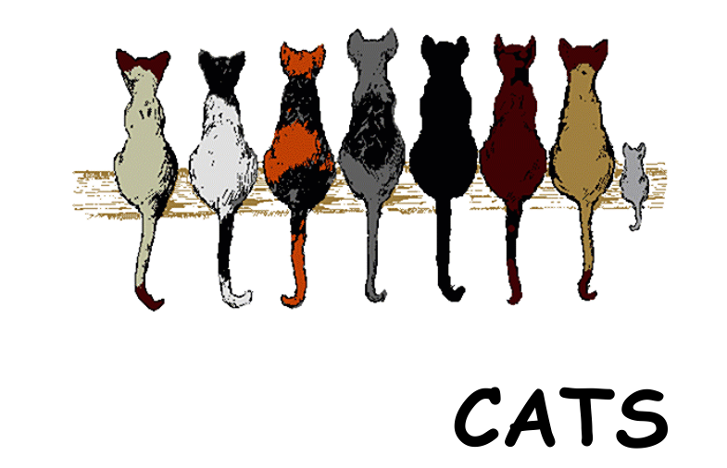

Slide 3
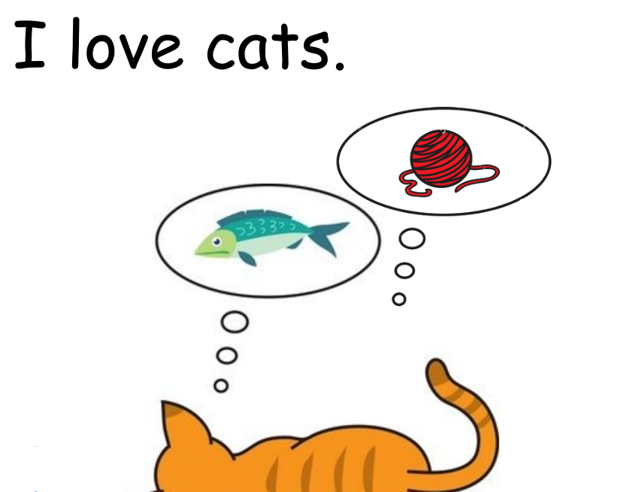

Slide 4
sad
happy

Slide 5
black
yellow
white

Slide 6
love
clean
dirty
I

Slide 7
I
bald
hairy
love

Slide 8
and
I
don’t
love
play

Slide 9
and
dogs
I
don’t
love
love

Slide 11
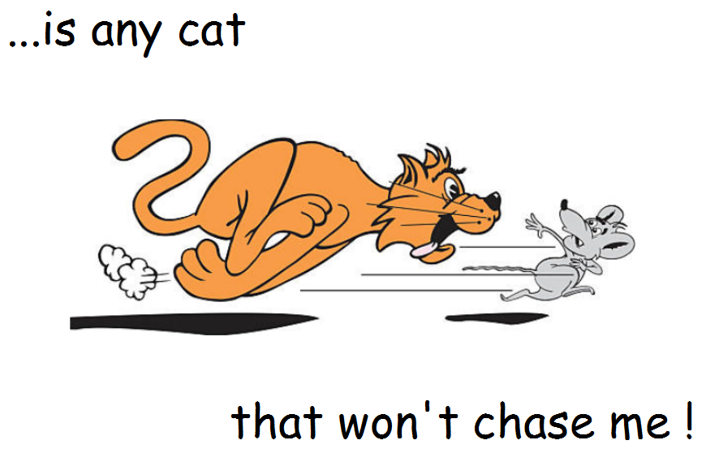

Slide 12
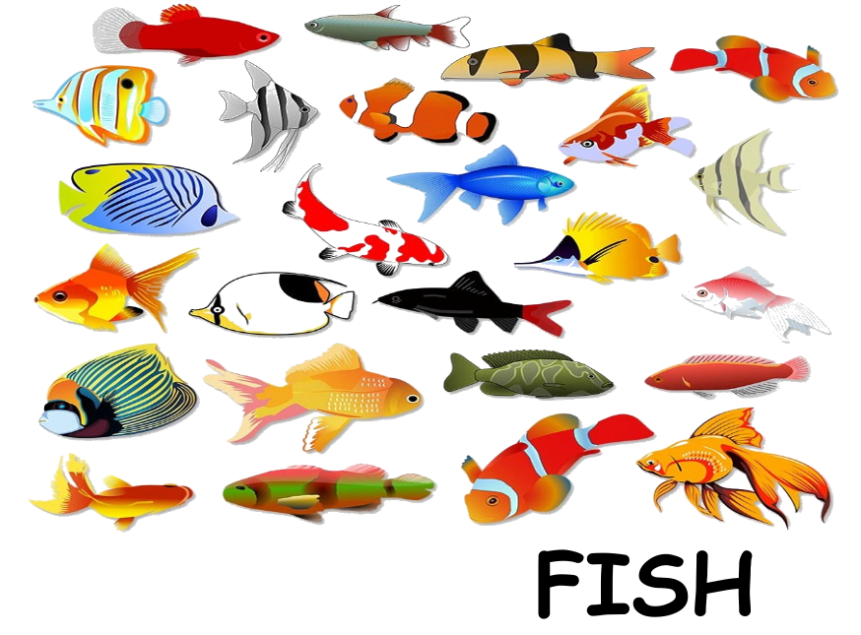

Slide 13
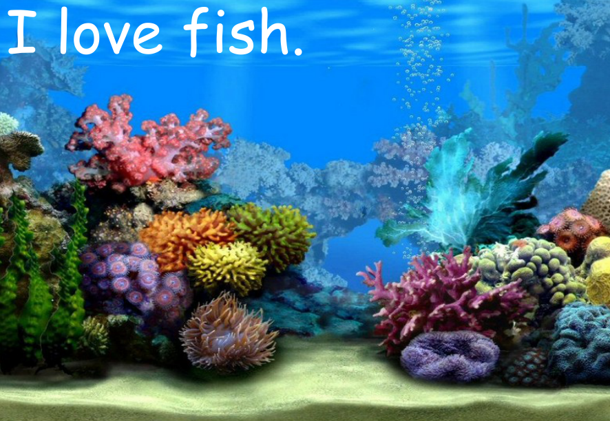

Slide 14
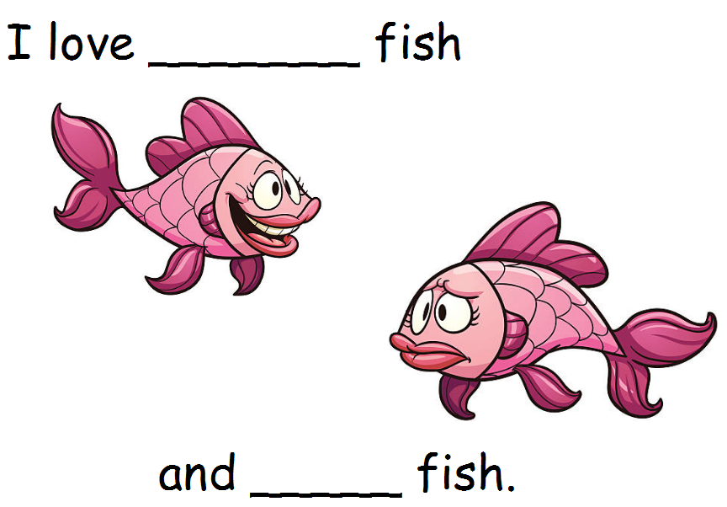

Slide 15
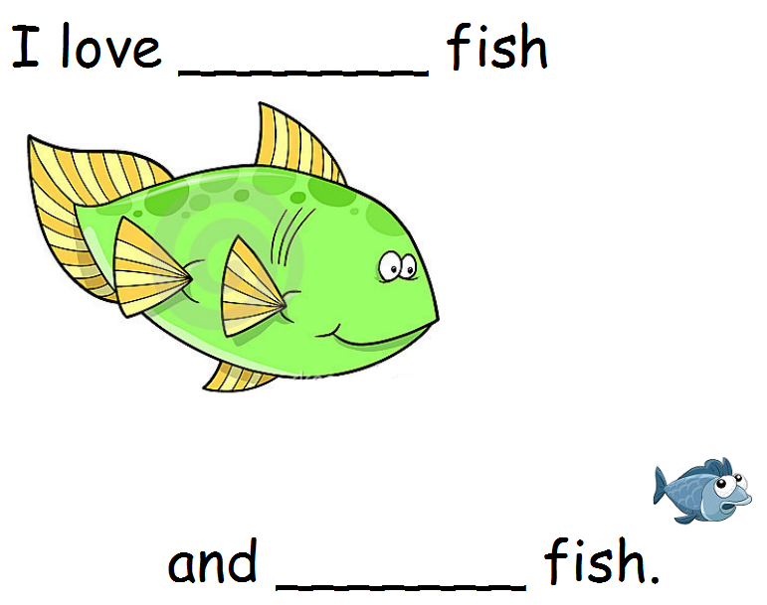

Slide 16
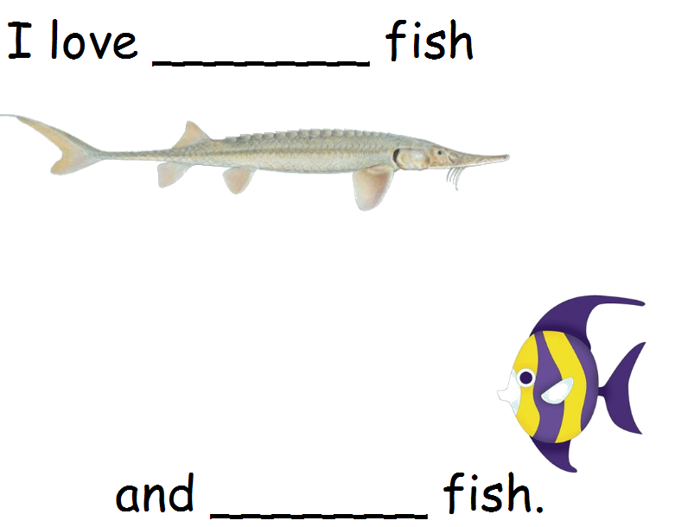
long
short

Slide 17
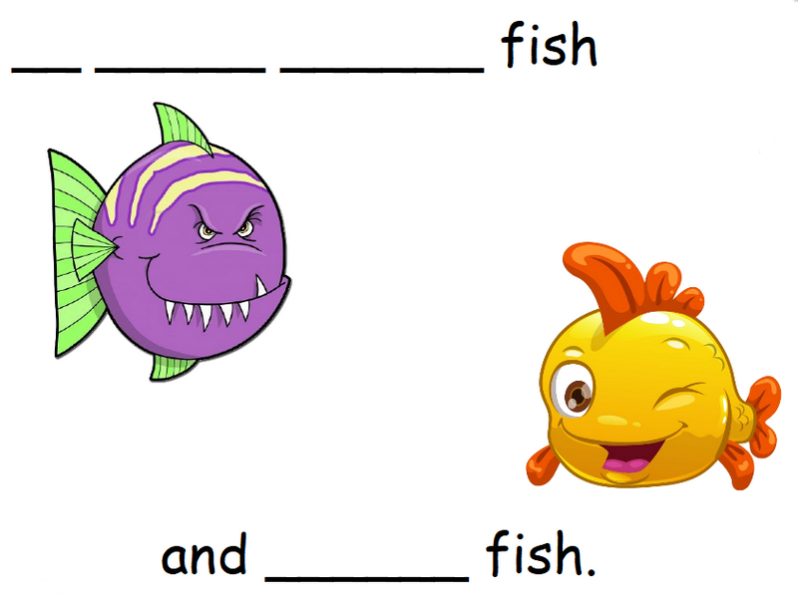
bad
good

Slide 18
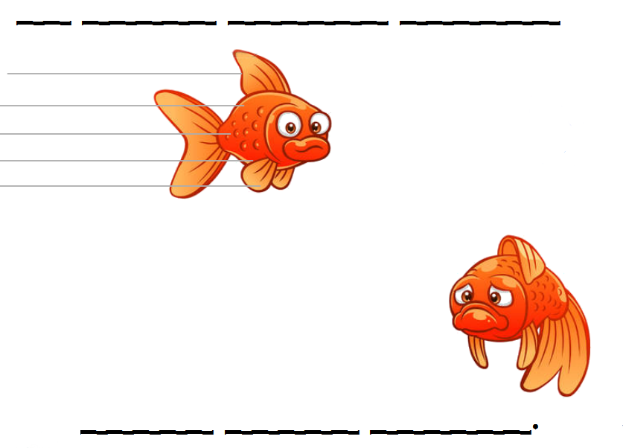
fast
slow

Slide 19
don’t
fly

Slide 21
